Slide 1
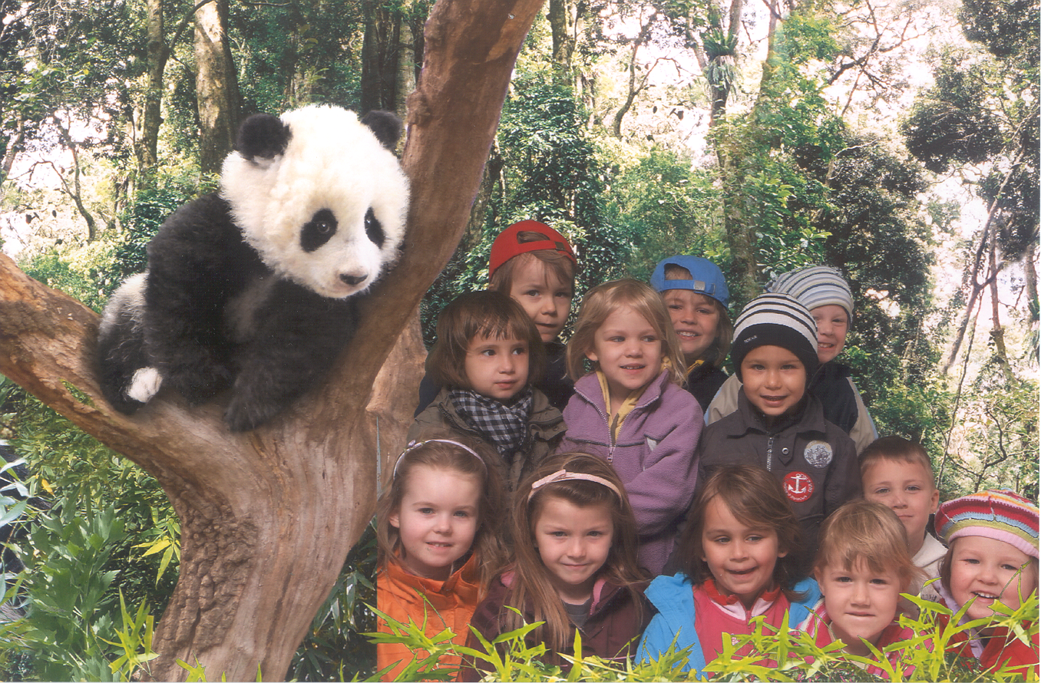
Mathias
Moriz
Raffael
Rosa
Vivy
Noah
Nino
Olivia
Sarah
Lea
Laura
Annika

