Slide 1
LLM Reference Architecture 0.1
1.1.1
LLM LUI
1.2.1
ILC LUI
1.2.2
CMS LUI
1.2.3
CTC LUI
1.2.4
PTC LUI
1.3.2
CMS
1.4.1
ILC
1.4.3
CTC
1.4.4
PTC
SOAP-IF
1.5.5
LLM DB
Database

Slide 2
LLM Reference Architecture 0.2
1.1.1
LLM LUI
… LUI navigation
… SOAP Call
1.2.1
ILC LUI
1.2.2
CMS LUI
1.2.3
CTC LUI
1.2.4
PTC LUI
1.3.2
CMS
SOAP-IF
Web-RUI
1.4.1
ILC
SOAP-IF
1.4.3
CTC
SOAP-IF
1.4.4
PTC
SOAP-IF
1.4.5
LRF
Web-RUI
SOAP-IF
Web-RUI
Web-RUI
Web-RUI
SOAP-IF
… Part of LLMCMS
Web-RUI
1.5.5
LLM DB
Database
… trigger event

Slide 3
LLM Reference Architecture 0.3
… Part of LLMCMS
… LUI navigation
1.1.1
LLM LUI
… trigger event
… SOAP Call
… Win prog invocation
1.2.1
ILC LUI
1.2.2
CMS LUI
1.2.3
CTC wrap LUI
1.2.4
PTC wrap LUI
1.3.3
CTC wrapper
1.3.4
PTC wrapper
1.3.2
CMS
CMS SOAP-IF
Web-RUI
CTC
RUI
PTC
1.4.1
ILC
1.4.5
LRF
RUI
LRF SOAP-IF
Web-RUI
Web-RUI
SOAP-IF
Web-RUI
1.5.5
LLM DB
Database

Slide 4

LLM Reference Architecture 0.4
… Part of LLMCMS
… LUI navigation
1.1.1
LLM LUI
… trigger event
… SOAP Call (Callback)
… Win prog invocation
LLF-Instance
1.2.1
ILC LUI
1.2.2
CMS LUI
1.2.3
CTC wrap LUI
CTC
1.3.3
CTC wrapper
RUI
1.3.2
CMS
CMS SOAP-IF
Web-RUI
1.4.1
ILC
1.4.5
LRF
LRF SOAP-IF
PTC
Web-RUI
Web-RUI
RUI
SOAP-IF
Web-RUI
1.5.5
LLM DB
Database

Slide 5
LLM Reference Architecture 0.5
… Part of LLMCMS
… LUI navigation
1.1.1
LLM LUI
… trigger event
… SOAP Call (Callback)
… Win prog invocation
LLF-Instance
1.2.1
ILC LUI
1.2.2
CMS LUI
1.2.3
CTC wrap LUI
CTC
1.3.3
CTC wrapper
RUI
1.3.2
CMS
CMS SOAP-IF
Web-RUI
1.4.1
ILC
1.4.5
LRF
LRF SOAP-IF
1.4.4
PTC
Web-RUI
Web-RUI
RUI
SOAP-IF
Web-RUI
1.5.5
LLM DB
Database

Slide 6
LLM System Configuration 0.4
… SOAP Call
LLM Local Terminal
LLM Local Terminal
LLM Local Terminal
1.1.1
LLM LUI
LLF-Instance
1.2.3
CTC wrap LUI
1.2.1
ILC LUI
1.2.2
CMS LUI
1.3.3
CTC wrapper
CTC
RUI
ILC HCU
LLM Server
PTC Box
1.3.2
CMS
Web-RUI
CMS SOAP-IF
Web-RUI
1.4.1
ILC
1.4.4
PTC
Web-RUI
1.4.5
LRF
LRF SOAP-IF
Web-RUI
LLM-DB
Server
LLM-WS
1.5.5
LLM-DB
Web-RUI

Slide 7
LLM System Configuration 0.5
… SOAP Call
LLM Local Terminal
LLM Local Terminal
LLM Local Terminal
1.1.1
LLM LUI
LLF-Instance
1.2.3
CTC wrap LUI
1.2.1
ILC LUI
1.2.2
CMS LUI
1.3.3
CTC wrapper
CTC
RUI
ILC HCU
LLM Server
PTC Box
1.3.2
CMS
Web-RUI
CMS SOAP-IF
Web-RUI
1.4.1
ILC
1.4.4
PTC
Web-RUI
1.4.5
LRF
LRF SOAP-IF
Web-RUI
LLM-DB
Server
LLM-WS
1.5.5
LLM-DB
Web-RUI

Slide 8


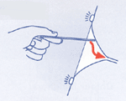
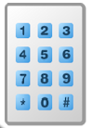
00 – Idle (logged out) Screen
LLM local terminal SW_5318
Place Card on Reader or Login

Slide 9











01 – Manual Login Screen
Please enter your Picture Code

Slide 10






02 – Senior Main Menu Screen
Welcome to LLM, Oma Reithofer !
ILC PTC CTC Results

Slide 11



05 – Training Schedule Notification
Time for Training, Oma Reithofer !
Do it Another Later Cancel

Slide 12



06 – Training Selection Screen
Select Your Training, Oma Reithofer !

Slide 13

07 – Training Result Screen
Your Training Results, Oma Reithofer:
Well Done! You‘re Improving!

Slide 14
08 – Distress Confirmation Screen
Need Help, Oma Reithofer ?
Yes, Please!
No, Thanks
Still 21 seconds till auto-alarm

Slide 15
09 – Process Active Screen
Training active for Oma Reithofer:
Why not drink some water ?

Slide 16
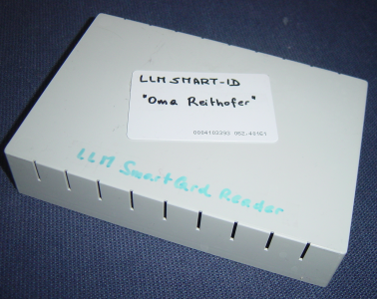

10 – Help Screen
Help for LLM topic
To log into the LLM system, either place your smart card on the reader
or press the „picture login“ button to input your picture code.
To use your picture code, it has to be configured into your user account by your administrator.

Slide 17
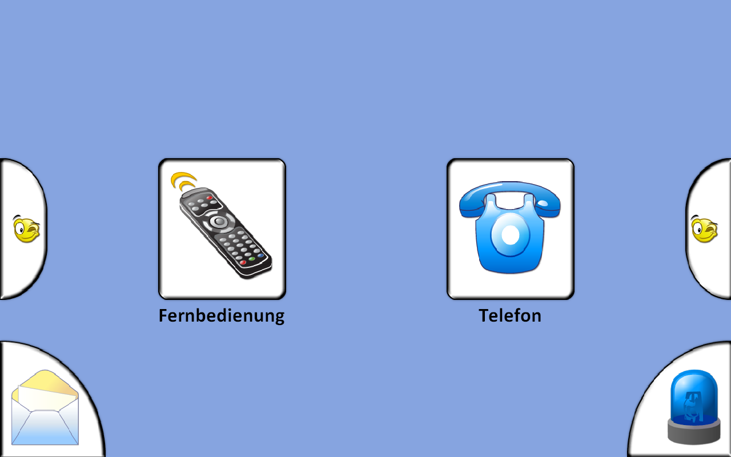
Sample ILC menu screen

Slide 18
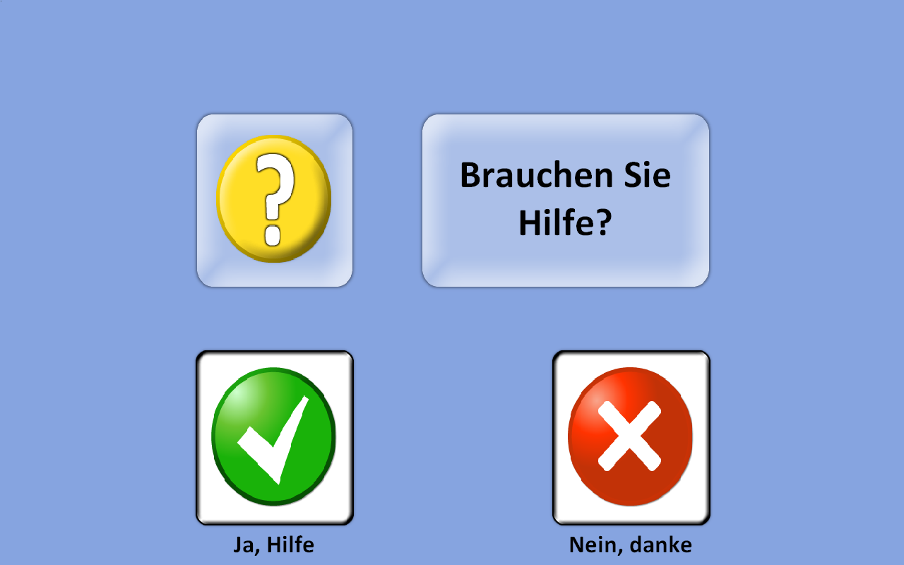
ILC Distress Confirmation Screen

