Slide 1
LLM Reference Architecture 0.1
1.1.1
LLM LUI
1.2.1
ILC LUI
1.2.2
CMS LUI
1.2.3
CTC LUI
1.2.4
PTC LUI
1.3.2
CMS
1.4.1
ILC
1.4.3
CTC
1.4.4
PTC
SOAP-IF
1.5.5
LLM DB
Database

Slide 2
LLM Reference Architecture 0.2
1.1.1
LLM LUI
… LUI navigation
… SOAP Call
1.2.1
ILC LUI
1.2.2
CMS LUI
1.2.3
CTC LUI
1.2.4
PTC LUI
1.3.2
CMS
SOAP-IF
Web-RUI
1.4.1
ILC
SOAP-IF
1.4.3
CTC
SOAP-IF
1.4.4
PTC
SOAP-IF
1.4.5
LRF
Web-RUI
SOAP-IF
Web-RUI
Web-RUI
Web-RUI
SOAP-IF
… Part of LLMCMS
Web-RUI
1.5.5
LLM DB
Database
… trigger event

Slide 3
LLM Reference Architecture 0.3
… Part of LLMCMS
… LUI navigation
1.1.1
LLM LUI
… trigger event
… SOAP Call
… Win prog invocation
1.2.1
ILC LUI
1.2.2
CMS LUI
1.2.3
CTC wrap LUI
1.2.4
PTC wrap LUI
1.3.3
CTC wrapper
1.3.4
PTC wrapper
1.3.2
CMS
CMS SOAP-IF
Web-RUI
CTC
RUI
PTC
1.4.1
ILC
1.4.5
LRF
RUI
LRF SOAP-IF
Web-RUI
Web-RUI
SOAP-IF
Web-RUI
1.5.5
LLM DB
Database

Slide 4

LLM Reference Architecture 0.4
… Part of LLMCMS
… LUI navigation
1.1.1
LLM LUI
… trigger event
… SOAP Call (Callback)
… Win prog invocation
LLF-Instance
1.2.1
ILC LUI
1.2.2
CMS LUI
1.2.3
CTC wrap LUI
CTC
1.3.3
CTC wrapper
RUI
1.3.2
CMS
CMS SOAP-IF
Web-RUI
1.4.1
ILC
1.4.5
LRF
LRF SOAP-IF
PTC
Web-RUI
Web-RUI
RUI
SOAP-IF
Web-RUI
1.5.5
LLM DB
Database

Slide 5
LLM Reference Architecture 0.5
… Part of LLMCMS
… LUI navigation
1.1.1
LLM LUI
… trigger event
… SOAP Call (Callback)
… Win prog invocation
LLF-Instance
1.2.1
ILC LUI
1.2.2
CMS LUI
1.2.3
CTC wrap LUI
CTC
1.3.3
CTC wrapper
RUI
1.3.2
CMS
CMS SOAP-IF
Web-RUI
1.4.1
ILC
1.4.5
LRF
LRF SOAP-IF
1.4.4
PTC
Web-RUI
Web-RUI
RUI
SOAP-IF
Web-RUI
1.5.5
LLM DB
Database

Slide 6
LLM Reference Architecture 0.7
… Part of LLMCMS
… LUI navigation
1.1.1
LLM LUI
… trigger event
… SOAP Call (Callback)
… Win prog invocation
LLF-Instance
(optional)
Authenticator (Smart-Card-Reader+Software)
1.2.1
ILC LUI
1.2.2
CMS LUI
1.2.3
CTC wrap LUI
1.3.3
CTC wrapper
1.3.2
CMS
CMS SOAP-IF
CTC
RUI
Web-RUI
1.4.1
ILC
1.4.5
LRF
LRF SOAP-IF
1.4.4
PTC
Web-RUI
Web-RUI
RUI
LLM-WS
Web-RUI
1.5.5
LLM DB
Database

Slide 7
LLM Reference Architecture 0.95
… Part of LLMCMS
… LUI navigation
1.1.1
LLM LUI
… trigger event
… SOAP Call (Callback)
… Win prog invocation
LLF-Instance
(optional)
Authenticator (Smart-Card-Reader+Software)
1.2.1
ILC LUI
1.2.2
CMS LUI
1.2.3
UxTC wrap LUI
1.3.3
UxTC wrapper
1.3.2
CMS
CMS SOAP-IF
UxTC
RUI
Web-RUI
1.4.1
ILC
1.4.5
LRF
LRF SOAP-IF
1.4.4
HxTC
Web-RUI
Web-RUI
RUI
LLM-WS
Web-RUI
1.5.5
LLM DB
Database

Slide 8
LLM System Configuration 0.4
… SOAP Call
LLM Local Terminal
LLM Local Terminal
LLM Local Terminal
1.1.1
LLM LUI
LLF-Instance
1.2.3
CTC wrap LUI
1.2.1
ILC LUI
1.2.2
CMS LUI
1.3.3
CTC wrapper
CTC
RUI
ILC HCU
LLM Server
PTC Box
1.3.2
CMS
Web-RUI
CMS SOAP-IF
Web-RUI
1.4.1
ILC
1.4.4
PTC
Web-RUI
1.4.5
LRF
LRF SOAP-IF
Web-RUI
LLM-DB
Server
LLM-WS
1.5.5
LLM-DB
Web-RUI

Slide 9
LLM System Configuration 0.5
… SOAP Call
LLM Local Terminal
LLM Local Terminal
LLM Local Terminal
1.1.1
LLM LUI
LLF-Instance
1.2.3
CTC wrap LUI
1.2.1
ILC LUI
1.2.2
CMS LUI
1.3.3
CTC wrapper
CTC
RUI
ILC HCU
LLM Server
PTC Box
1.3.2
CMS
Web-RUI
CMS SOAP-IF
Web-RUI
1.4.1
ILC
1.4.4
PTC
Web-RUI
1.4.5
LRF
LRF SOAP-IF
Web-RUI
LLM-DB
Server
LLM-WS
1.5.5
LLM-DB
Web-RUI

Slide 10


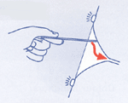
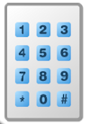
00 – Idle (logged out) Screen
LLM local terminal SW_5318
Place Card on Reader or Login

Slide 11











01p – Manual Picture Login Screen
Please enter your Picture Code

Slide 12
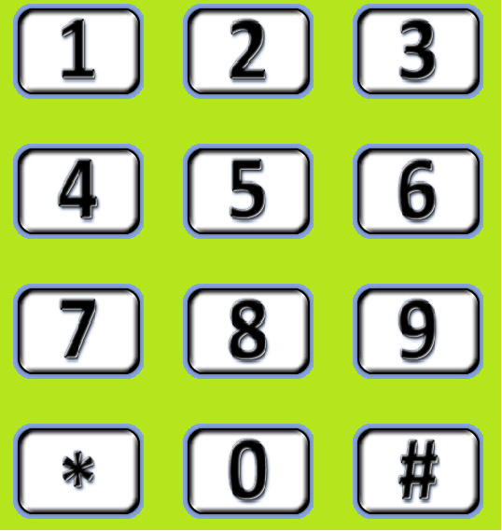
01n – Manual Numeric Login Screen
Please enter numeric Login Code

Slide 13







02 – Senior Main Menu Screen
Welcome to LLM, Oma Reithofer !
ILC PTC CTC Results

Slide 14



05 – Training Schedule Notification
Time for Training, Oma Reithofer !
Do it Another Later Cancel

Slide 15



06 – Training Selection Screen
Select Your Training, Oma Reithofer !

Slide 16

07 – Training Result Screen
Your Training Results, Oma Reithofer:
Well Done! You‘re Improving!

Slide 17
08 – Distress Confirmation Screen
Need Help, Oma Reithofer ?
Yes, Please!
No, Thanks
Still 21 seconds till auto-alarm

Slide 18
09 – Process Active Screen
Training active for Oma Reithofer:
Why not drink some water ?

Slide 19
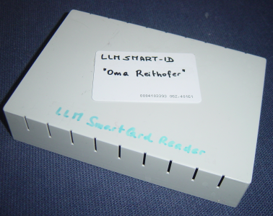

10 – Help Screen
Help for LLM topic
To log into the LLM system, either place your smart card on the reader
or press the „picture login“ button to input your picture code.
To use your picture code, it has to be configured into your user account by your administrator.

Slide 20
11 – Schedule List
Schedules Oma Reithofer
Every Tuesday from 10:00 thru 10:30
Physical Training „Endurance“
Every Day 09:00-09:30 and 17:00-17:30
Cognitive Training „Crosswords“
May 24, 2010, 08:00
Phone call to „Kurti Reithofer“
Birthday!

Slide 21
12 – Schedule Editor
New Schedule Oma Reithofer
When:
What:
Remark:
Every Tuesday from 10:00 thru 10:30
Edit
Cognitive Training „sudoku“
Edit
?
Time for some training?
Edit
TXT

Slide 22
13 – LUI Text Editor
Text
Bi
1
2 ABC
3 DEF
Bicycle
4 GHI
5 JKL
6 MNO
Bilateral
7 PQRS
8 TUV
9 WXYZ
Birthday
* +
0 _
# A/a
bite
[blank]
boring

Slide 23
14 – LUI Schedule Time Editor
Schedule Time
1
2 ABC
3 DEF
Once
4 GHI
5 JKL
6 MNO
Every
7 PQRS
8 TUV
9 WXYZ
Weekday
* +
0 _
# A/a
Monday
[blank]
Tuesday

Slide 24
15 – LUI Activity Type Selector
Activity Type
1
2 ABC
3 DEF
Physical
Training
4 GHI
5 JKL
6 MNO
Cognitive Training
7 PQRS
8 TUV
9 WXYZ
Phone Call
* +
0 _
# A/a
Reminder
!
[blank]

Slide 25
16 – LUI Activity Selector
Select Activity
1
2 ABC
3 DEF
Cardio
4 GHI
5 JKL
6 MNO
Endurance
7 PQRS
8 TUV
9 WXYZ
* +
0 _
# A/a
[blank]

Slide 26

06.06.00 - LLM RUI Screen layout
Page Header
Message Area
<user-message>
Context Path / Breadcrumb List
Menu Item
Working Area of selected menu item
Selected Menu Item
Menu Item
Menu Item
Menu Item
Software & Version Configuration ID(s)
Copyright

Slide 27
06.06.01 - LLM RUI Login Screen
Log In to LLM system at site <schwechat_eHome>
<no-errors>
Not logged in
Breadcrumb Menu Position list
Menu Item
Log In
Login to LLM system
Menu Item
Menu Item
Menu Item
Username:
kurti_reithofer
Password:

Reset Form
Login
Software & Version Configuration ID(s)
Copyright

Slide 28







06.06.06 -RUI Property List
Property Editor
<no-errors>
Kurti Reithofer
<current LLM-DB context path>
Log Out Log In
Name
Type
Value
Control
^^
anumber
NUMBER
1503
1
Properties
astring
STRING
A rose is a rose
2
alist
PROPS
3
Schedules
Seniors
Menu Item
Software & Version Configuration ID(s)
Copyright
Import
Export

Slide 29
06.06.06.02 -RUI Import Dialogue
Property Editor
<no-errors>
Kurti Reithofer
<current LLM-DB tree context path>
Import properties from file to <context-path>
Log Out Log In
Name
Type
Value
Control
<filename>
Browse…
^^
anumber
NUMBER
1503
1
Properties
astring
STRING
A rose is a rose
2
No overwrite
alist
Import
3
always overwrite
Schedules
Seniors
Menu Item
PROPS
List conflicts to confirm
xx% complete
Yes
<conflict messages …>
No
Yes to All
No to All
Software & Version Configuration ID(s)
Copyright
Import
Export

Slide 30
06.06.04 – OBSOLETE: RUI Single Property Edit
Property Editor
<no-errors>
Not logged in
<Current property tree path>
Log Out Log In
Property Editor
Property Editor
Property Name:
Preferred_perfume
Menu Item
Menu Item
Menu Item
Type:
NUMBER
Value:
4711
Cancel
Save
Software & Version Configuration ID(s)
Copyright

Slide 31
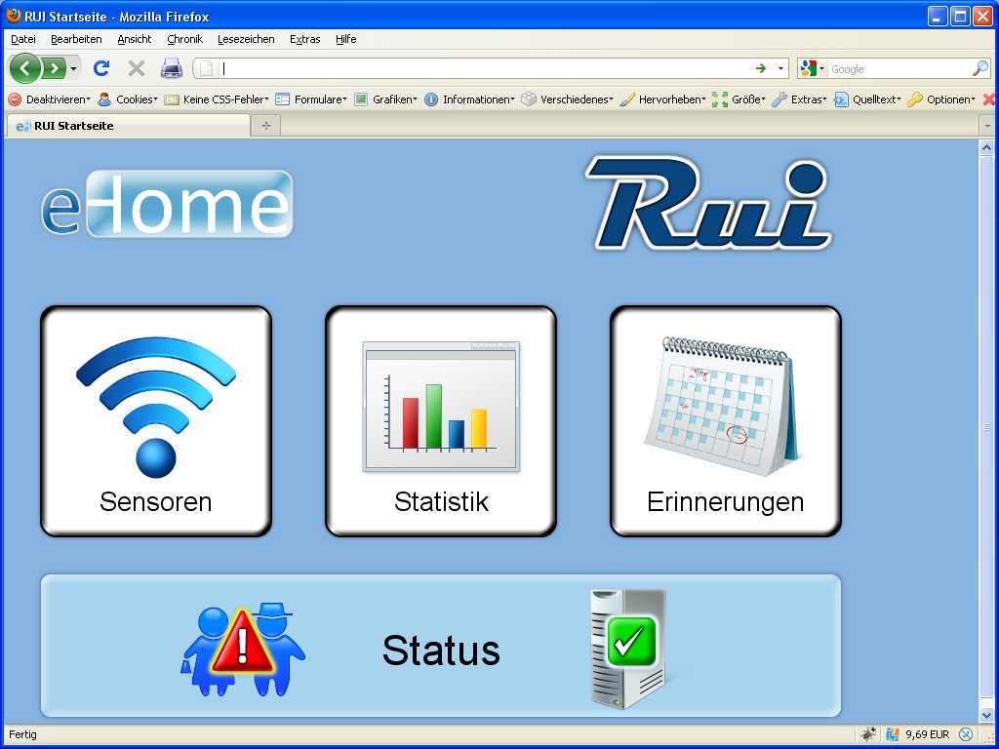
Sample ILC RUI user menu screen

Slide 32
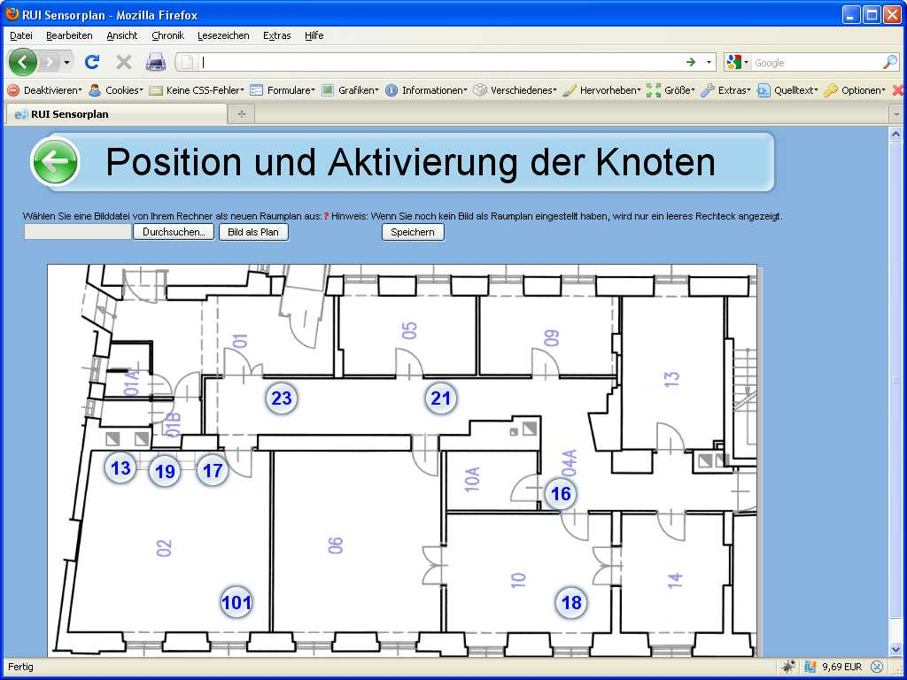
Sample ILC RUI user config screen

Slide 33
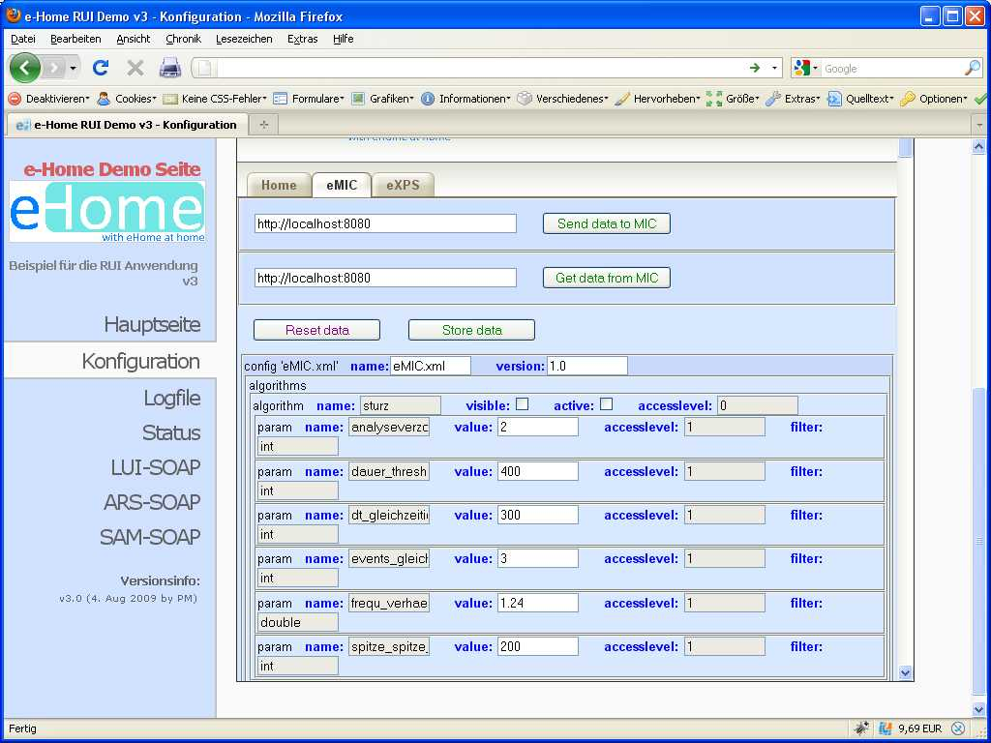
Sample ILC RUI expert screen

Slide 34
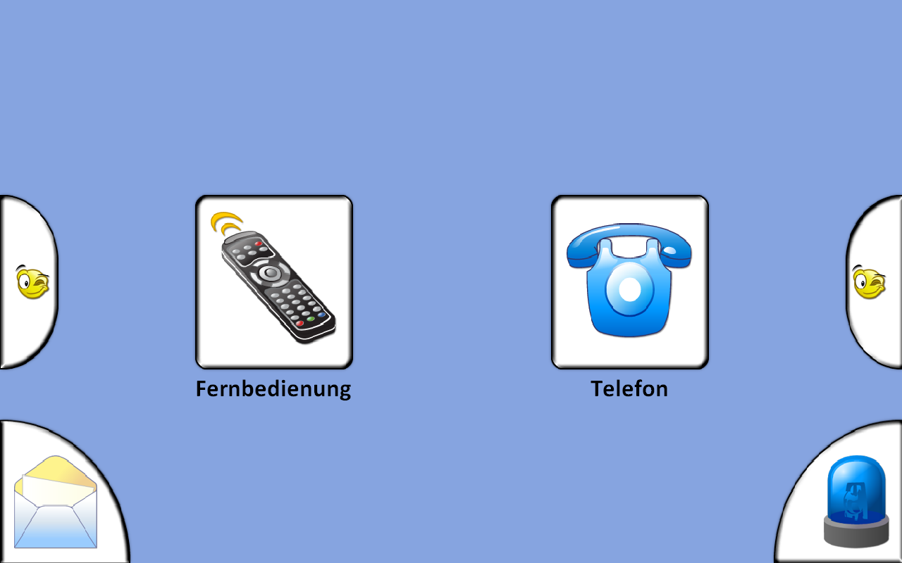
Sample ILC menu screen

Slide 35
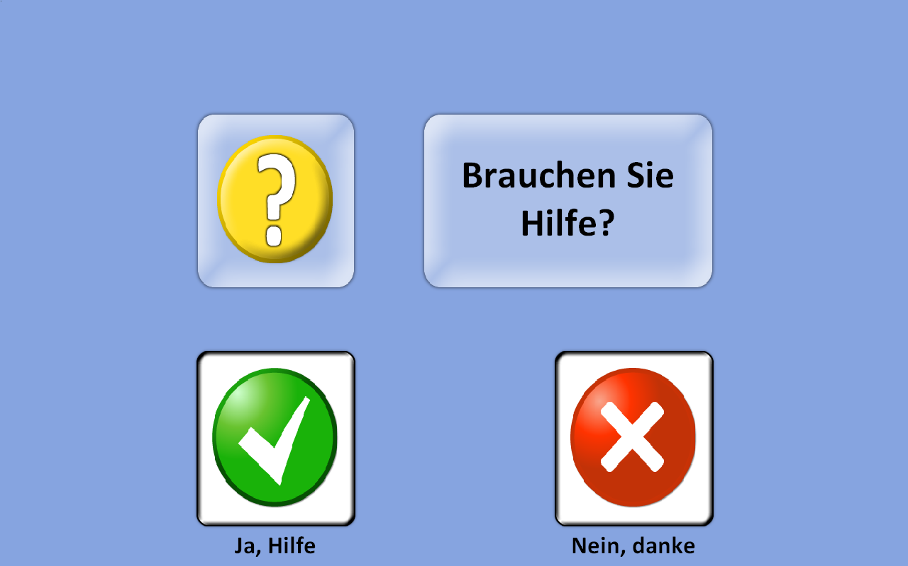
ILC Distress Confirmation Screen

